Slide 1

US gas prices compared to world events
Data analysis and visualization
by
Benjamin Harkins, Jay Cha & Frank Kimani

Slide 2
Goal of OUR Data Visualization
The purpose of this website and group project is to explore the relationship between gas prices in the US and various historical events over a time of 28 years. It has been speculated that certain historical events have had some effect on the rise and fall of gas prices. This project is intended to show those relationships and prove or disprove whether they are significantly related or not.

Slide 3
Datasource(S)
Our datasource(s) is mainly from Dataworld: https://data.world/eia-wind/us-retail-gasoline-prices
We pulled a csv file of the Weekly Prices between 1993-2021 (28 years)

Slide 4
Data Retrieval/Analysis Technologies
Data retrieval: csv, json, flask api
Data storage: mongoDB
Front end: HTML,CSS,JS, Bootstrap, D3, Plotly
Other: Animate Scroll Library

Slide 5
Charts
Iraq War: Aimed to show the correlation between the Iraq war and US gas prices.
Other Years: Gas prices comparison and orange tooltip feature to show other world events including the 2008 Recession, Hurricane Katrina, Nigeria militant attacks on oil pipeline and threats of Israeli attack on Iran.
The chart slider helps narrow down to a given time

Slide 6
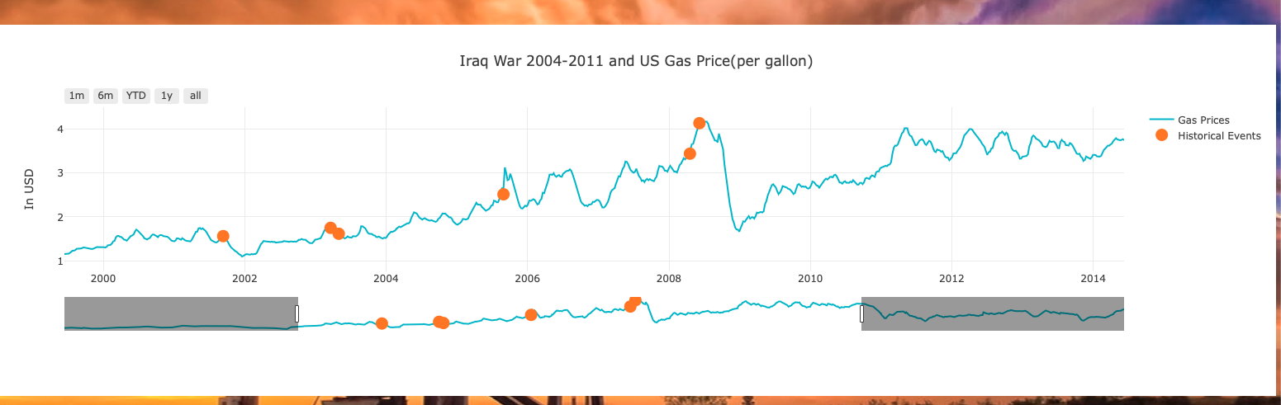
Charts - Iraq

Slide 7
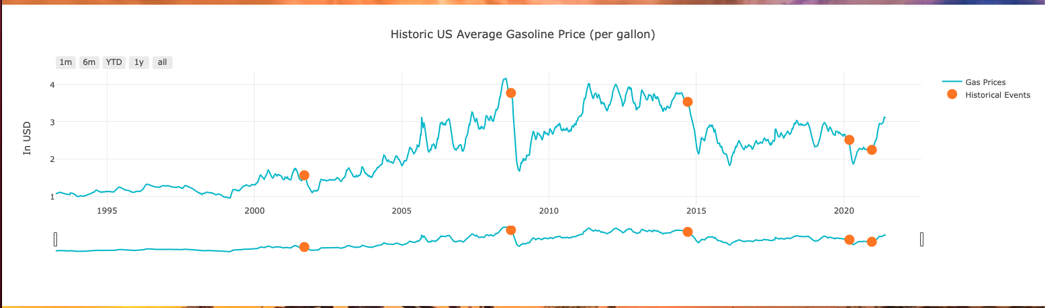
Charts - Other

Slide 8
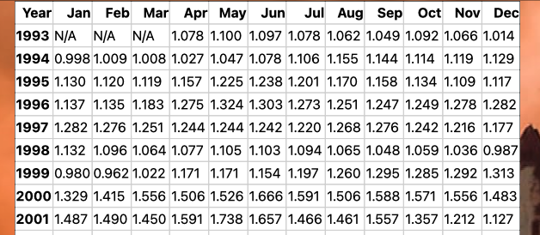
Data table

Slide 9
Comparison
Visualization of US gas prices each year during that timeframe(1993-2020).
On the charts, plotly tooltips display the price per gallon(and events if any) at a given time

Slide 10
Observations
Iraq War: During this time, there was a small upward trend on gas prices.
Other factors associated with up or down spikes include Katrina, the recession of 2008, Covid-19 pandemic, etc.
Note: We display other notable events as a reference to show what was happening at given times.

Slide 11
DATA Analysis
Based on the data and events surrounding it, we observe that major events have a correlation with upward or downward spikes in US gas prices.
Iraq: On our charts, we see during the timeframe of the Iraq war (the longest US military engagement) there was an upward trend in gas prices at the pump.
US Gas Prices: There is a notable upward trend in US gas prices at the pump some time after a major event occurs.
There is a notable spike associated with other events such as Hurricane Katrina, the recession of 2008,
There is a notable downward spike associated with Covid-19 pandemic and worldwide shutdowns.

Slide 12
Resources
https://data.world/eia-wind/us-retail-gasoline-prices
https://www.eia.gov/dnav/pet/pet_pri_gnd_dcus_nus_m.htm
https://www.quandl.com/api/v3/datasets/OPEC/ORB.json
https://data.bls.gov/timeseries/APU000074714
http://thedailyviz.com/2012/03/17/visualizing-gas-prices-by-state-income-and-time/
https://en.wikipedia.org/wiki/World_oil_market_chronology_from_2003#2004_to_2008:_rising_costs_of_oil

